Slide 1


Team Case Analysis: Novo Nordisk A/S
Jen Hancock
Joseph Mandeville
Marissa Hardimon
Renee Little
SPEAKER: JENNIFER HANCOCK

Slide 2

Introduction
Section Speaker: Jennifer Hancock

Slide 3
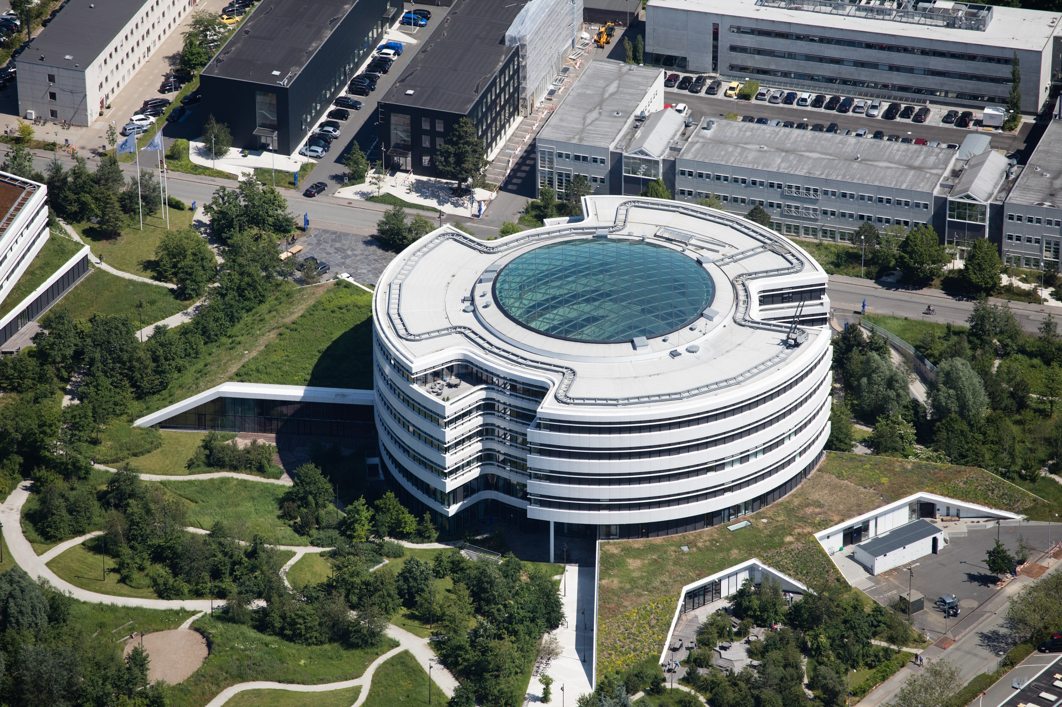
Novo Nordisk
Globally-Founded Healthcare Company
  Headquarters Outside of Copenhagen, Demark (Our Heritage, 2023)
  U.S. Headquarters in Plainsboro, New Jersey (Our Heritage, 2023)
Started with Focus on Diabetes
  Helped with Secondary Diseases to Diabetes
    Heart Conditions and Weight Management
Mission of Defeating Chronic Disease
  Utilize Essential Medicine
  Create a Cure for These Diseases
Primarily a Pharmaceutical Company
Paving Way for the Future of Diabetes Care
Serves Over One Hundred Countries
  Sixteen Production Site
  Ten Research and Development Centers
Novo Nordisk headquarters, Denmark
Aerial photo of NN1 and NN2, Novo Nordisk Danish headquarters in Bagsværd. Inaugurated 2014. Architects: Henning Larsen
SPEAKER: JENNIFER HANCOCK

Slide 4
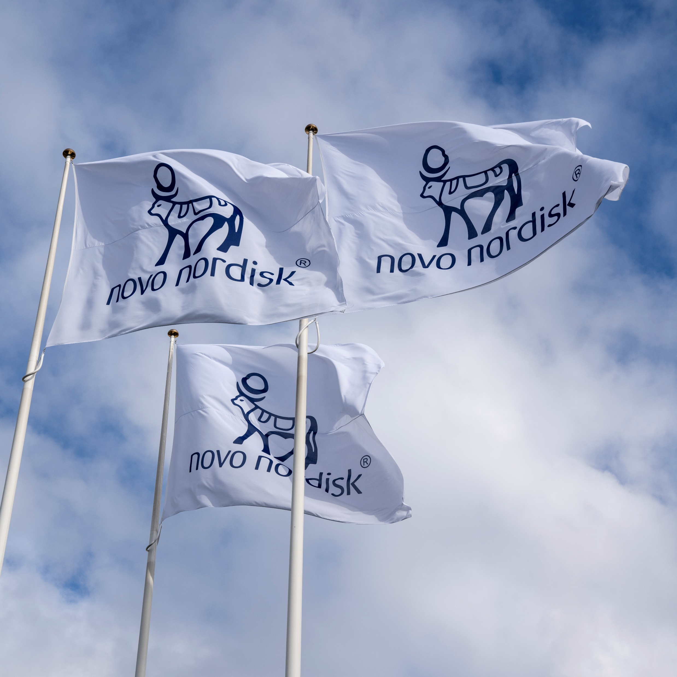
Brief History
1923
  Began to Produce Insulin (Our Heritage, 2023)
1946
  Developed Long-Lasting Insulin
1970’s
  Created First Oral Contraception
  Marketed First Growth Hormone
1985
  Developed First Insulin Pen (Rex et al., 2012)
1987
  First Human Insulin Products Using Genetically-Engineered Yeast Cells (Our Heritage, 2023)
Novo Nordisk flag
SPEAKER: JENNIFER HANCOCK

Slide 5

Background and
Problem
Identification
Section Speaker: Jennifer Hancock
SPEAKER: JENNIFER HANCOCK

Slide 6

Problem One: Cost
Novo’s Weight-Loss Drugs are Costly
Insurance Companies Not Covering These Drugs (Wainer, 2025)
These Drugs are Cheaper in Other Countries (Teng, 2024)
SPEAKER: JENNIFER HANCOCK

Slide 7
Problem Two: Side Effects
The second controversy is listing the side effects and ensuring the patient is aware of these effects. Like some other pharmaceutical companies, the labeling and advertising of these side effects are thrown to the sideline in hopes that they do not deter sales.
On their website, Novo states they cannot provide information about their prescription medicine and users must find another route for information on their medicine; they put that responsibility on the prescribing provider (Who We Are, 2024).
Should the company who makes the product not be able to give detailed information about their own product?
Side effects of the drugs cannot only be mild but have led to serious adverse reactions such as cancer and stomach paralysis (Goodman, 2023).
SPEAKER: JENNIFER HANCOCK

Slide 8

Literature
Review
Section Speaker: Marissa Hardimon
SPEAKER: MARISSA HARDIMON

Slide 9

Findings
“Novo Nordisk Way” (Corporate Governance, 2024)
  Conducts Itself in Responsible Way
Checks and Balances (Corporate Governance, 2024)
  Board of Directors for Oversight
Honesty
  Customer Loyalty
Provides Medication to Those in Need
SPEAKER: MARISSA HARDIMON

Slide 10
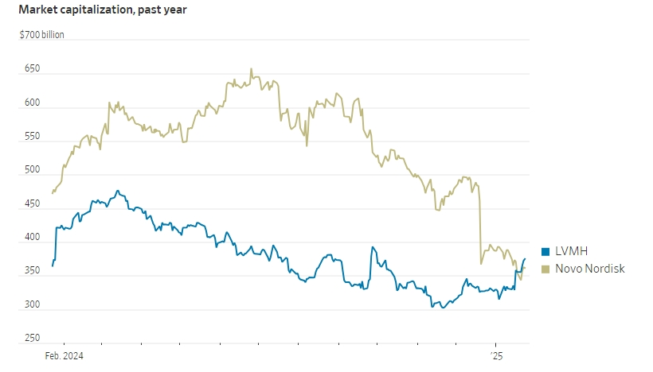
Market Cost vs. Competitor
Surpassed LVMH in the Past Year (Wall Street Journal Staff, 2025)
  Most Valuable Company in Europe
Peak Annual Sales of $150 Billion (Wall Street Journal Staff, 2025)
SPEAKER: MARISSA HARDIMON

Slide 11
More
Novo Nordisk Findings
Retain Muscle Mass
Reduce the frequency of injection or additional health benefits beyond weight loss.
Affordable Cost
Increase in Sales Revenue
Side Effects: stomach paralysis, pancreatitis and bowl obstructions (Seal, 2025).
Lead to Medical Emergencies
Solution: provide safe medication when used consistently with product labeling (Teng, 2024).
SPEAKER: MARISSA HARDIMON

Slide 12
Strengths
Weaknesses
Opportunities
Threats
Section Speaker: Renee Little
SPEAKER: RENEE LITTLE

Slide 13

SWOT Analysis
STRENGTHS
Largest Company for Diabetes Products
Strong Product Portfolio (Bindzus, 2023)
Global Presence
Diversified Revenue Sources
WEAKNESSES
Regulatory Scrutiny
High Research and Development Costs
Company’s Business Model (Wainer, 2025)
OPPORTUNITIES
Increasing Need of Diabetes Treatment
Development in New Markets
Strategic Partnerships and Acquisitions
Biopharmaceuticals (Bindzus, 2023)
THREATS
Generic Competition (Chopping & Loftus, 2025)
Safety Measures for Taking Medication
Reimbursement and Pricing Pressure
SPEAKER: RENEE LITTLE

Slide 14
Recommendations
Section Speaker: Renee Little

Slide 15

Leverage Strengths
Ensure Fair Access and Price
  Consider Collaborating with Governments
Utilize Global Prescence (Wainer, 2025)
Improve Brand Reputation and Loyalty
  Develop Distribution Channels
SPEAKER: RENEE LITTLE

Slide 16

Mitigate Weaknesses and Threats
Offer Financial Assistance Programs (Chopping & Loftus, 2025)
  Help Patients Afford Medication
Offer Telehealth Services
  Patients Can Consult with Professionals
Ensure Fair Prices and Access to Drugs
Utilize Transparency in Communication
SPEAKER: RENEE LITTLE

Slide 17

Conclusion
Section Speaker: Joseph Mandeville

Slide 18

Dominance and Challenges
Dominance
Global Leader in Healthcare
  Dominant Force in Global Pharmaceutical Market
Innovative Diabetic Medicine
  Long-Lasting Insulin
  Insulin Pens
  Leading the Way in Obesity Treatment
Challenges
Controversial Weight-Loss Drugs
  Excessive Cost
  Side Effects
    Lack of Transparency
Risks to Profitability
  Entrance of Generic Manufacturers
  Challenges in Market Access in Various Regions
SPEAKER: JOSEPH MANDEVILLE
Notes:
Novo Nordisk has become a leader in the global pharmaceutical market, especially regarding diabetes care. They have developed groundbreaking treatments for diabetes like long-lasting insulin and insulin pens. Novo has also recently led the way in obesity treatment. However, the company is facing significant challenges. There are rising concerns about the excessive cost and side effects of its weight-loss drugs. A lack of transparency of these side effects have generated great controversy for Novo. Additionally, the entrance of generic competition and market access issues pose risks to Novo’s profitability.

Slide 19

Growth Opportunities and Securing Success
Growth Opportunities
Emerging Markets Offer Growth
Strategic Partnerships Allow for Diversification
Global Diabetes Prevalence Showcases a Driving Need for Novo Nordisk Products
Securing Success
Collaboration for Fair Pricing and Availability of Drugs is Essential
Transparency is Key
Balance Profitability with Ethical Practices
Remain Committed to the Mission
SPEAKER: JOSEPH MANDEVILLE
Notes:
Despite these challenges, Novo Nordisk has ample opportunity to grow. Emerging markets and strategic partnerships present chances for Novo to diversify and further develop its business. An increasing global prevalence of diabetes further increases the demand for Novo’s products. To secure its success, Novo must address key issues. Ensuring fair pricing and availability of its drugs in underserved markets is essential. Novo must also increase transparency with its communication about side effects of its drugs to patients to help rebuild trust and reputation. Balancing profitability with ethical practices is crucial. Commitment to its mission of fighting chronic diseases will be integral to Novo’s future.

Slide 20
References
Bindzus, N. (2023). Novo Nordisk A/S – Understanding Its Recent Record-Breaking Performance [HD(R) Thesis, Copenhagen Business School]. https://research-api.cbs.dk/ws/portalfiles/portal/98726947/1649778_hd2del_thesis_final.pdf
Chopping, D., & Loftus, P. (2025, February 5). Novo Nordisk Outlook Provides Some Welcome Relief. The Wall Street Journal. https://www.wsj.com/health/pharma/novo-nordisks-wegovy-drug-sales-miss-expectations-773136e7
Corporate Governance. (2024). Novo Nordisk. https://www.novonordisk.com/about/corporate-governance.html
Goodman, B. (2023, October 5). Researchers Link Popular Weight Loss Drugs to Serious Digestive Problems for ‘Hundreds of Thousands’ Worldwide. Cable News Network. https://www.cnn.com/2023/10/05/health/weight-loss-drugs-serious-digestive-problems-study/index.html
Our Heritage. (2023). Novo Nordisk. https://www.novonordisk-us.com/about/our-heritage.html

Slide 21
References (Continued)
Rex, J., Jensen, K. H., & Lawton, S. A. (2012). A Review of 20 Years’ Experience with the Novopen® Family of Insulin Injection Devices. Clinical Drug Investigation, 26(7), 367-401. https://doi.org/10.2165/00044011-200626070-00001
Seal, D. (2025, January 28). Novo Nordisk’s Ozempic Gets FDA Approval as Kidney-Disease Treatment. The Wall Street Journal. https://wsj.com/health/pharma/novo-nordisks-ozempic-gets-fda-approval-as-kidney-disease-treatment-7aafbf66
Teng, T. (2024, September 25). Novo Nordisk Boss in U.S. Grilling Over Prices For Weight-Loss Drugs. Euronews. https://www.euronews.com/business/2024/09/25/novo-nordisk-ceo-open-to-discussing-weight-loss-drug-pricing-with-us-politicians
Wainer, D. (2025, February 6). The Obesity Market Is Growing Just Fine. But Investors Want to Know What’s Next. The Wall Street Journal. https://www.wsj.com/health/pharma/the-obesity-market-is-growing-just-fine-but-investors-want-to-know-whats-next-3425c30c
Wall Street Journal Staff. (2025, January 24). Novo Nordisk Vaults Above LVMH as Europe’s Biggest Company. The Wall Street Journal. https://www.wsj.com/livecoverage/stock-market-today-dow-sp500-nasdaq-live-01-24-2025/card/novo-nordisk-vaults-above-lvmh-as-europe-s-biggest-company-ISc2Pn5CYIzFMiAUdouO
Who We Are. (2024). Novo Nordisk. https://www.novonordisk-us.com/about/who-we-are.html.

